Slide 1
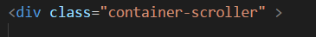
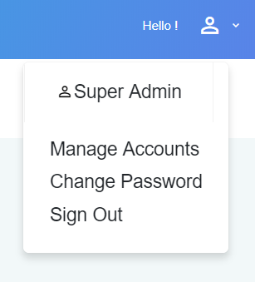
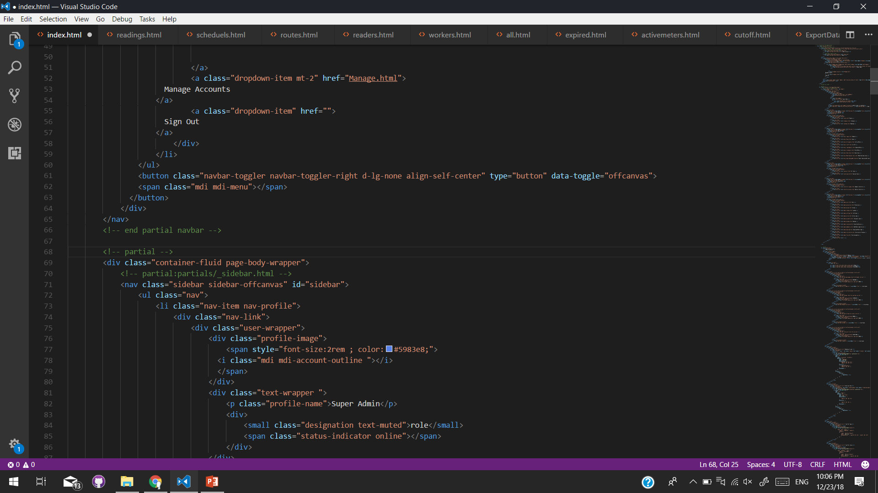
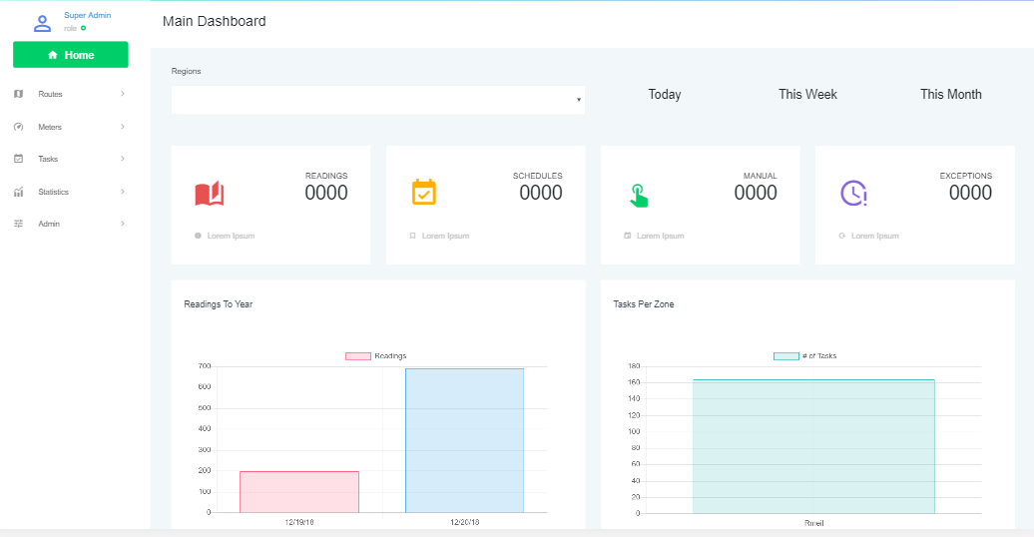
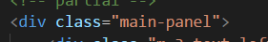
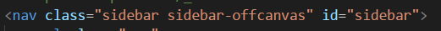
All pages
<!-- contain all the page content -->
<!-- partial:partials/_navbar.html -->
←Container for this section of the page exluding the top navbar →

Slide 2
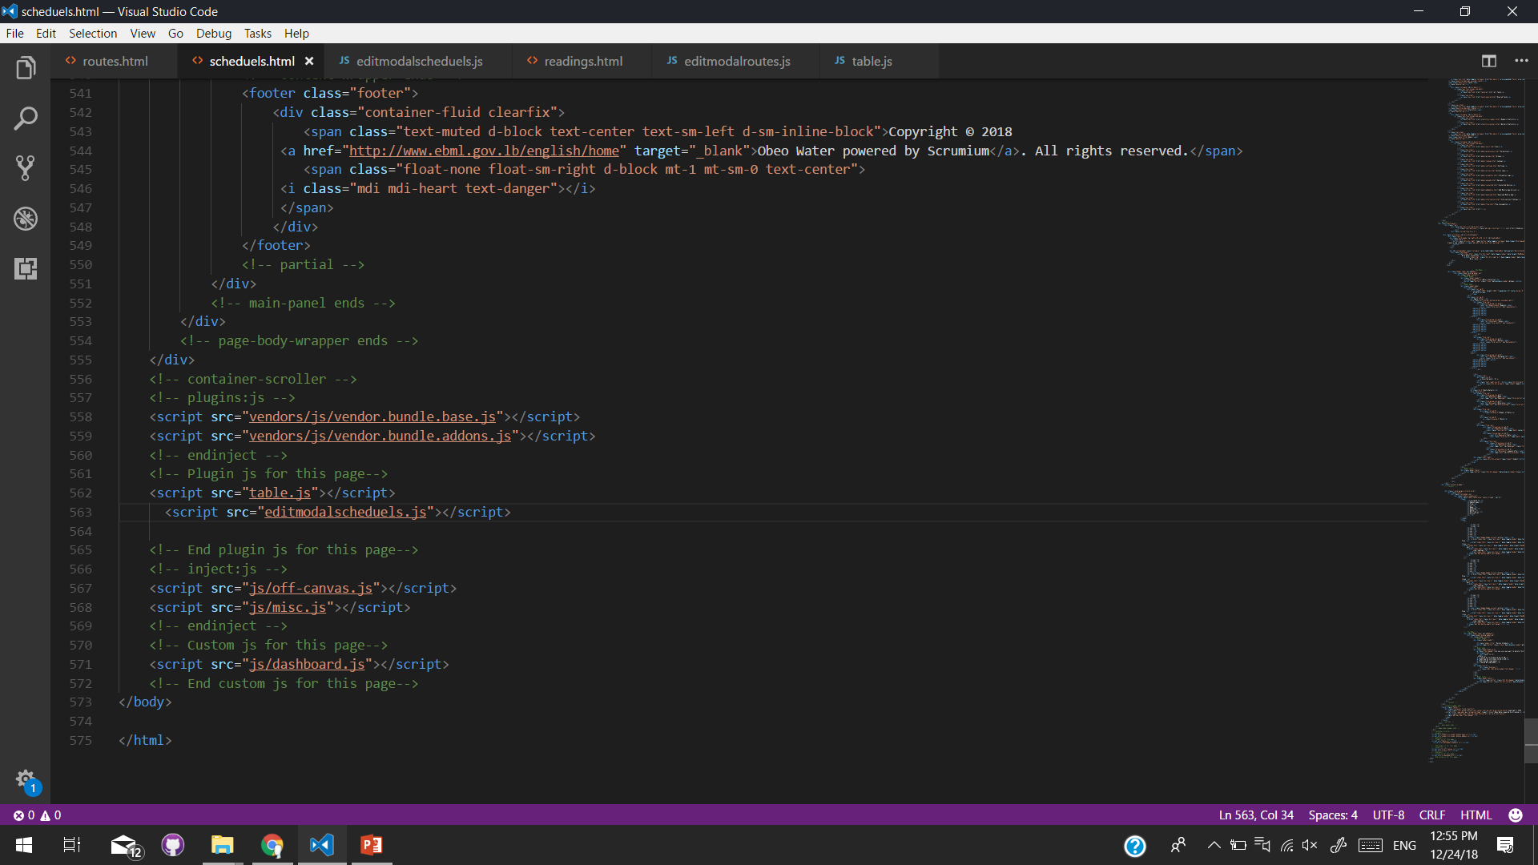
The script for table
Some modals are opened directly and some other are opened via JS
This because the same modal may be opened for an create or an edit or other purpose but I require to change some text or to have some values from the database
I’ve not assigned any ids because you can put the same id you have used before

Slide 3
All icons
<i class=“mdi mdi-’type’ ”></i>
Type can be found from this link
https://materialdesignicons.com/
Please before any upload to the hosting minify all CSS and JavaScript
All google maps documentation
https://developers.google.com/maps/documentation/embed/guide
You need to get an api key and replace it in the iframe code
The cuurent code will be disabled after some time

Slide 4
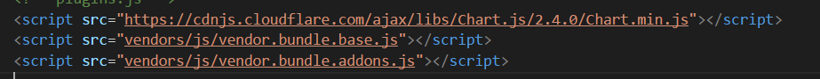
Home (index.html)
<!-- region select -->
<!-- time filter -->
<!-- MANUAL value -->
<script src="chart.js"></script>
Script to fill all chart
Documentation can be found following this link
https://www.chartjs.org/

Slide 5
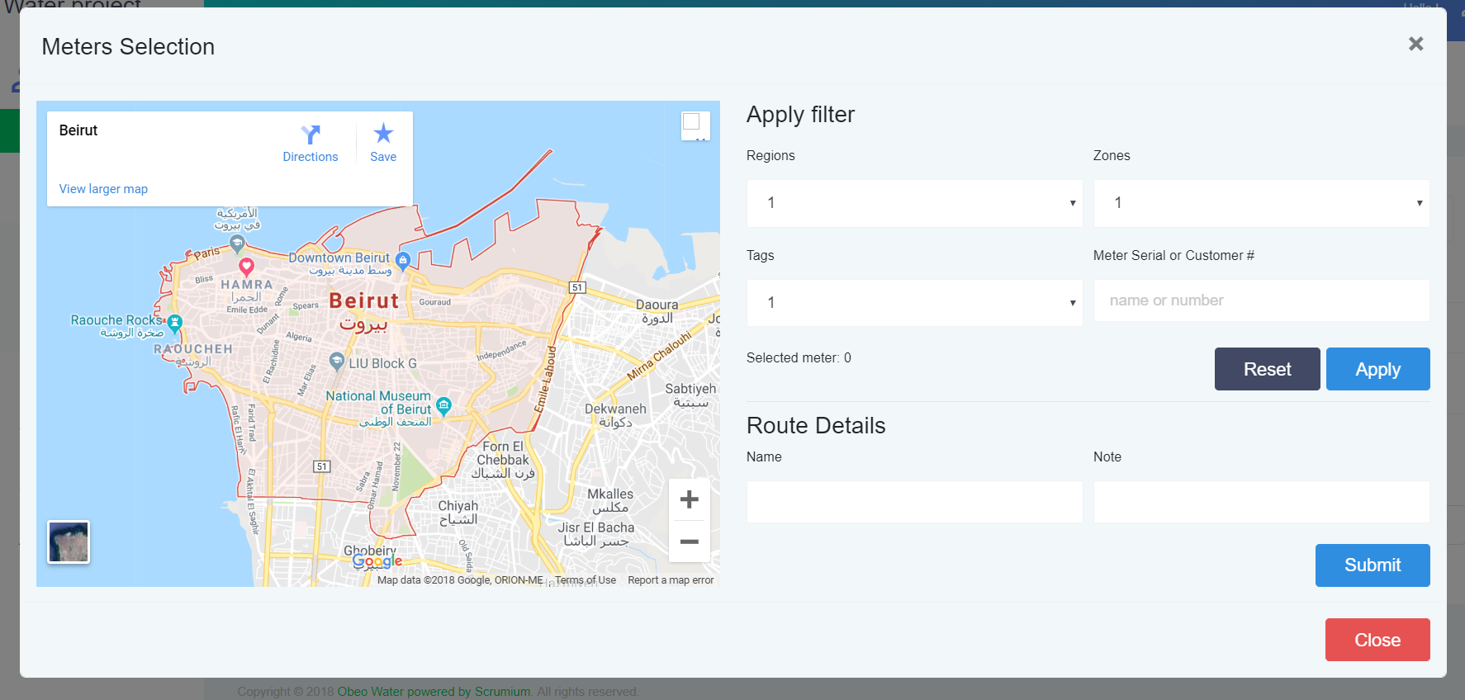
routes.html
<!-- google maps -->
This is an iframe
<!-- filters -->
<!-- Route Details -->

Slide 6
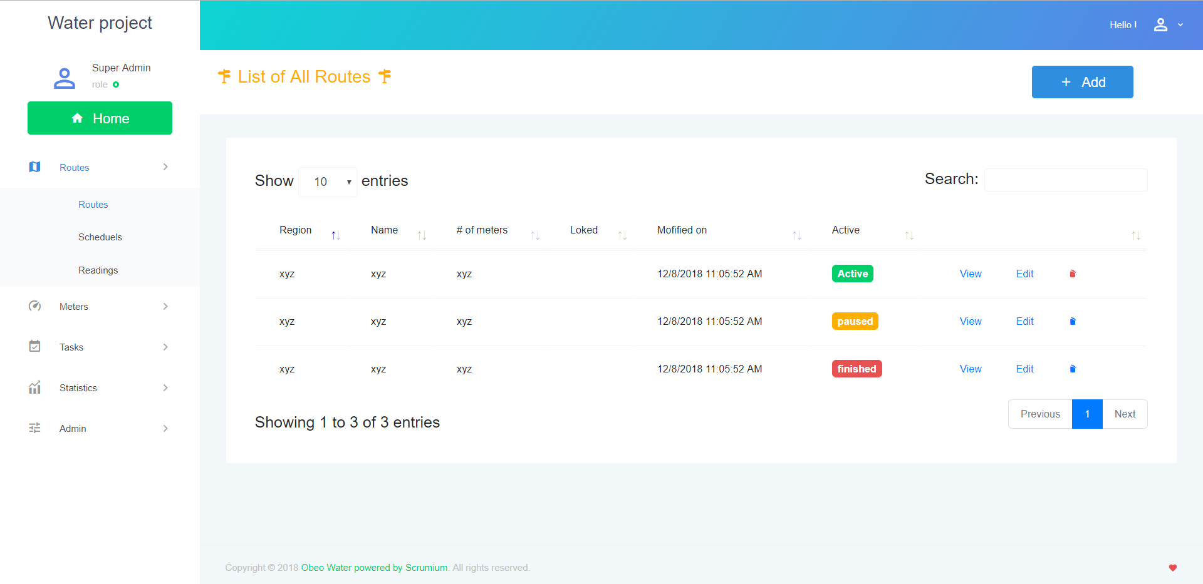
In all pages like this you can change
the table code with your own for a fastest work
But try the set the thead color with the same color used with the page title (bootstrap color)
You can also use some custom jQuery table design

